Slide 1
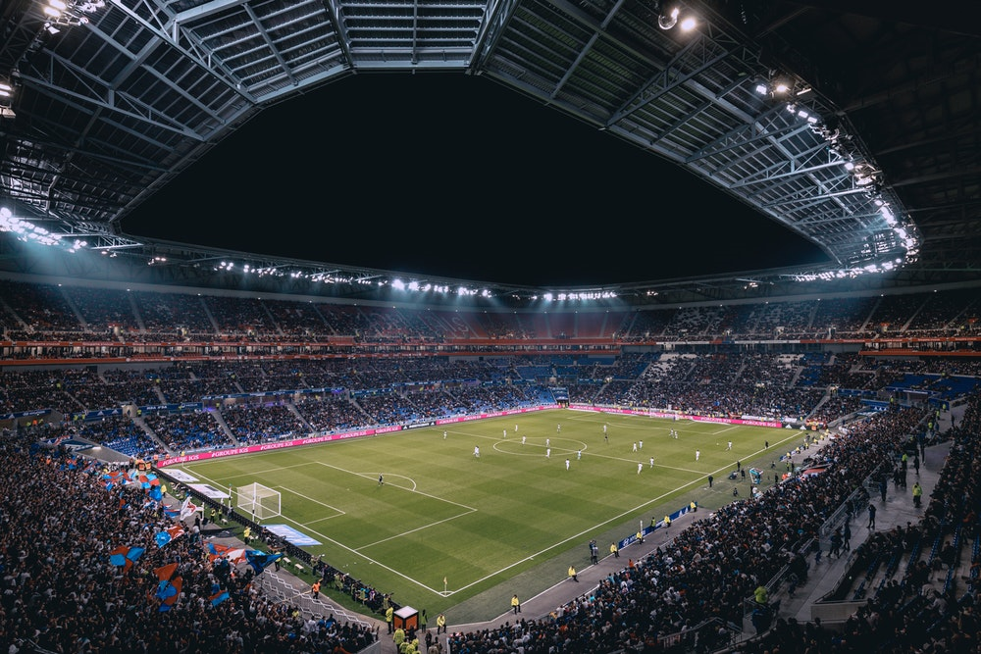
An introduction to
A-LEVEL PHYSICAL EDUCATION
THURSDAY 22nd June 2023

Slide 2
Theory Structure & Assessment…
PAPER 1
PAPER 2
Each paper is divided into 3 units.
At the end of each topic (within each unit) students will complete a ‘core’ assessment (38/45 marks)- will include extended questions.
Scores will be compared to target grades to measure performance throughout the course & identify strengths & areas for improvement.
In Term 2 you will complete an Autumn Assessment- similar format to core assessments.
In March 2020 you will complete a formal ‘Spring Assessment’ (105 marks, 2 hours).
There will also be additional assessments focusing on Extended Questions.
1. Applied Anatomy & Physiology
4. Exercise Physiology and Biomechanics
2. Skill Acquisition
5. Sports Psychology
3. Sport & Society
6. Sport in Society & Technology

Slide 3
Exam & Coursework Structure & Assessment…
Exam Assessment- Theory (70%):
Paper 1 – 2 hour exam (105 marks)
Paper 2 – 2 hour exam (105 marks)
Both 35% and include MCQ, Short answer and Extended/Synoptic
Non-Exam Assessment- Practical (30%)
Performer or Coach in 1 activity
2 assessment areas and tactics/strategies
Written analysis of performance
Analyse yourself or another performer (4,000+ word written document)
Evaluate – corrective measures/links to theory

Slide 4
History of Success! A-Level PE Examination Results - Summer 2022
Summer 2022-
GRADE OVERVIEW
Summer 2019
Summer 2022
GRADE | % | No. of Students
A* | 0 | 0
A | 0 | 0
B | 22% | 2
C | 22% | 2
D | 33% | 3
E | 22% | 2
A*-A | 0% | 0 from 9
A*-B | 22% | 2 from 9
A*-C | 44% | 4 from 9
A*-D | 78% | 7 from 9
GRADE | % | No. of Students
A* | 10% | 1
A | 20% | 2
B | 50% | 5
C | 10% | 1
D | 10% | 1
A*-A | 30% | 3
A*-B | 80% | 8
A*-C | 90% | 9
A*-D | 100% | 10
Grade A* | Grade A | Grade B | Grade C | Grade D
Evelyn Westhrop | Amelia Jessop | Oscar Mulligan | Ben Clarke | Tom Dunk
 | Jamie Sturrock | Jack Hatfield
 |  | Daniel Green
 |  | Lee Dapkus
 |  | Cormac Austin

Slide 5
History of Success! GCSE PE Examination Results - Summer 2022
% of GRADES 1-9
Summer 2022-
GRADE OVERVIEW
Summer 2019
Summer 2022
Grade 9’s | Grade 8’s | Grade 7’s | Grade 6’s | Grade 5’s
Callum O’Neil | Fin Appleby | Shayne Chihlayo | Frank Gregory | Kieran Doherty
Jacob Flitton | Jake Green | Aaron Bird | Brodie Davidson
Owen Hurley | Jack Falconer | Joshua Fallis
Jake Wright |  | William Hodgson
Mayvin Gurung |  | Joey Humphrey
Reece Merenda
Ruben Caley
Dylan Greenwood
GRADE | % | No. of Students
9 | 2% | 1
8 | 24% | 11
7 | 20% | 9
6 | 20% | 9
5 | 24% | 11
4 | 11.0% | 5
3 | 0.0 | 0
2 | 0.0 | 0
1 | 0.0 | 0
9-8/A* | 24% | 11 from 46
9-7/A*-A | 46% | 21 from 46
9-6/A*-B | 65.2 | 30 from 46
9-5/A*-C | 87.0 | 40 from 46
9-4/A*-C | 100.0 | 46 from 46
GRADE | % | No. of Students
9 | 47% | 8
8 | 16% | 3
7 | 26% | 5
6 | 11% | 2
5 | 1 | 5%
4 | 0.0 | 0
3 | 0.0 | 0
2 | 0.0 | 0
1 | 0.0 | 0
9-8/A* | 58% | 11
9-7/A*-A | 84% | 16
9-6/A*-B | 95% | 18
9-5/A*-C | 100 | 19
9-4/A*-C | N/A | N/A

Slide 6
PE ‘Teaching & Learning Cycle’
EVERLEARNER
- students complete a VIDEO assignment & create a detailed mind map
(to develop prior knowledge)
2. GCSE PE LESSON/S
- taught the topic area
(focus on application & evaluation of the topic)
3. EVERLEARNER
students complete a TEST assignment on the topic.
(pass mark- 70%+)
5. CORE ASSESSMENT
- x30 short answer & 6/9 mark extended question
(assess learning & identify strengths/weaknesses)
4. REVISION RESOURCES
- students create revision cards or mind maps
(to recall and consolidate learning)

Slide 7
‘Student-Athlete’ Expectations…
Achieved A* and A grades for A-Level PE
Achieved 80% (pass mark is 70%) on Everlearner tests prior to learning each topic in the classroom.
Students apply ‘excellent’ levels of effort to each lesson & homework task.
Created high quality Revision Resources on an ongoing basis.
Achieved their target grade for each of the core, end of chapter & formal mock assessments (Autumn, Spring, and January Assessments).
Strong independent learning skills- highly organised and could manage their free time to complete homework early on and to a high standard.
Completed additional independent learning (extra revision for assessments- practice questions, re-complete Everlearner videos & tests).
Practical- trained & played to the highest level in their sport, completing 4+ recordings for NEA evidence.
Written Coursework- followed the PE dept guidance & put significant time into each draft of their work.

Slide 8
Taking Responsibility…
What top sportspeople and A*/A grade A-Level PE students have in common:

Slide 9
Revision Resources…
You will create Revision Cards & Mind Maps prior to every core assessment that you take.
Creating revision resources will help you recall and reinforce your learning from lessons to prepare for Core Assessments.
You will arrive to each core assessment with your revision resources to evidence your preparation.
1. Revision Cards for A01 Content- key knowledge about the topic area (e.g. definitions, descriptions of key concepts, etc…)
2. Mind Maps for A02 (application) to sporting examples, the concept within the question.
AND A03 (evaluation & analysis) content- strengths/weaknesses, advantages/disadvantages and breaking the concept down into its parts.

Slide 10
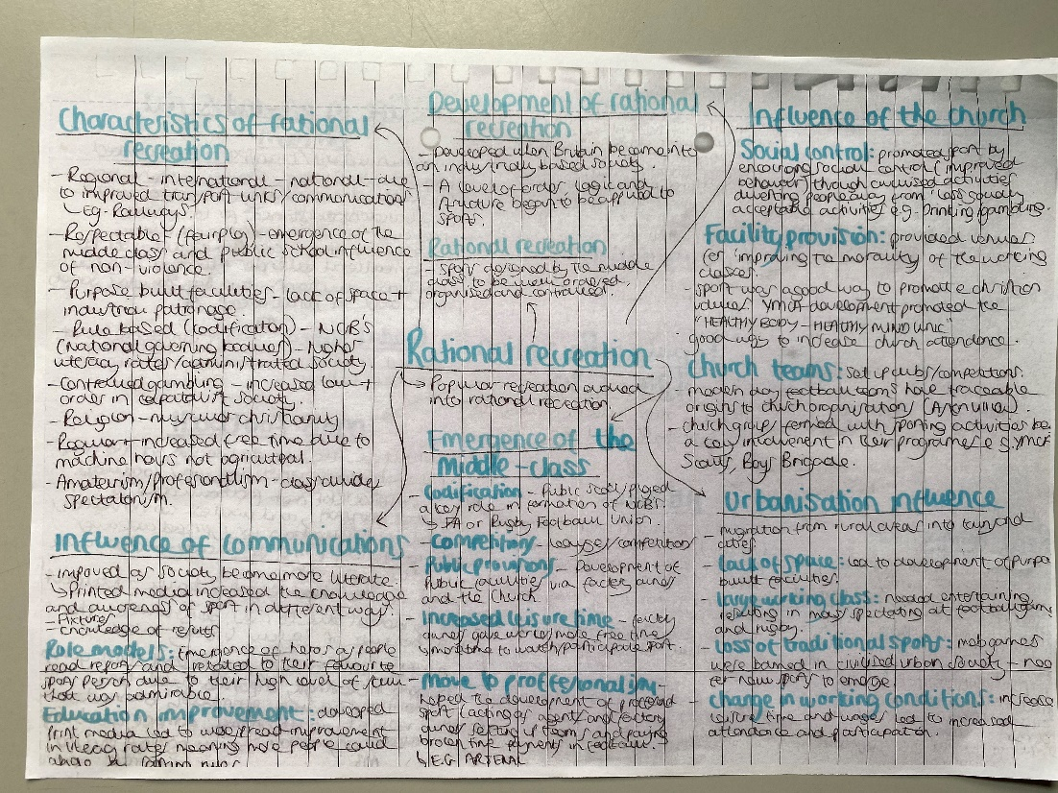
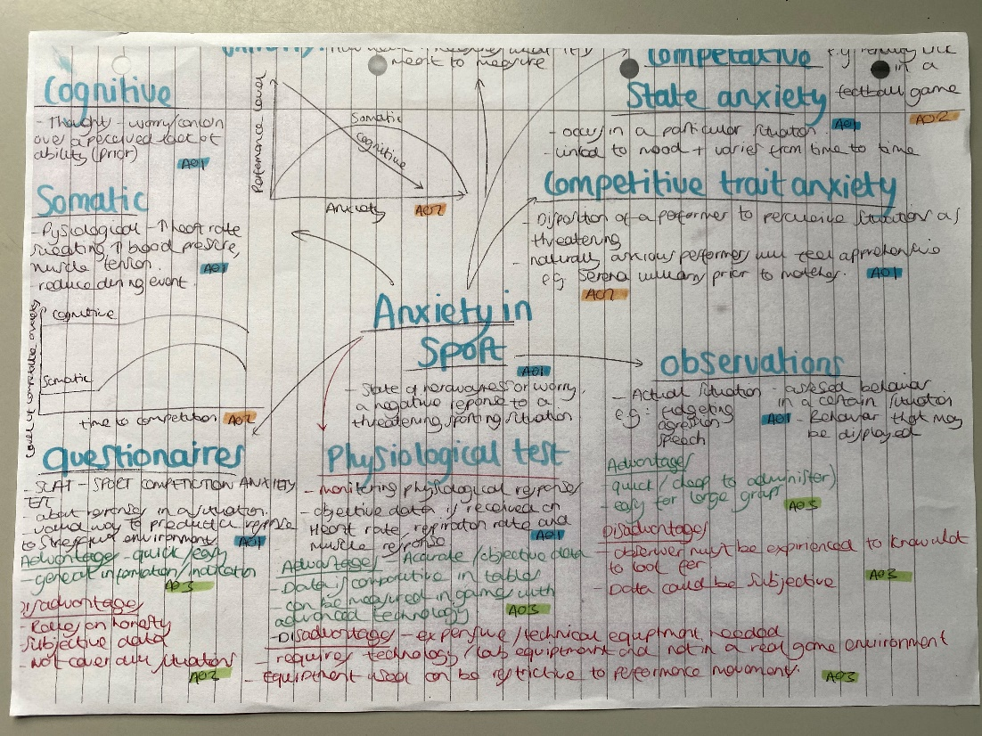
Example Revision Resources…
Below are example of mind maps created by one of the summer exam 2020 students who went on to achieve an A* grade.

Slide 11
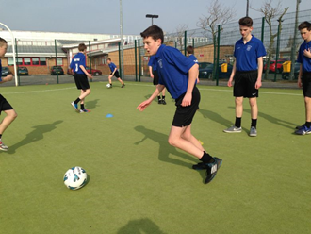
Practical Assessment (20%)…
You will need to perform OR coach one of the following practical activities to high club/district/county/national standard.
You must be playing your sport throughout the course to reach the highest possible level.
Boxing, Diving, Netball, Trampolining,
Football, Equestrian, Rock Climbing, Volleyball,
Athletics, Gaelic Football, Rowing, Blind Cricket,
Badminton, Golf, Rugby (League/Union), Boccia,
Basketball, Gymnastics, Sculling, Goal Ball,
Camogie, Handball, Skiing, Powerchair Football,
Canoeing, Hockey, Snowboarding, Polybat,
Cricket, Hurling, Squash, Table Cricket,
Cycling, Kayaking, Table Tennis, Wheelchair Basketball,
Dance, Lacrosse, Tennis, Wheelchair Football, Wheelchair Rugby

Slide 12
Search your sport/assessment criteria…
GOOGLE SEARCH- AQA A-Level PE
http://filestore.aqa.org.uk/resources/pe/specifications/AQA-7582-SP-2016.PDF

Slide 13
Search your sport/assessment criteria…

Slide 14
Getting Ready for A-Level PE this Summer!
The below Course Preparation tasks are due the day prior to your first A-Level PE lesson in September:
Complete Summer Work- this has been emailed to you by the 6th Form Team & myself.
Identify NEA Practical Sports- refer to this PowerPoint & the A-Level PE specification.
Resources- Purchase A-Level PE Textbooks & Revision Guide (if you want your own) on Amazon.
Year 12 Volunteering- identify the sports club/team you’d like to work with in 2023.
Everlearner Account- Log on to your Everlearner account and familiarise yourself with the website- you will receive an email from Everlearner.com to do this.
Please email me (well in advance of your first September lesson) if you have any issues with the above tasks.

