Slide 1
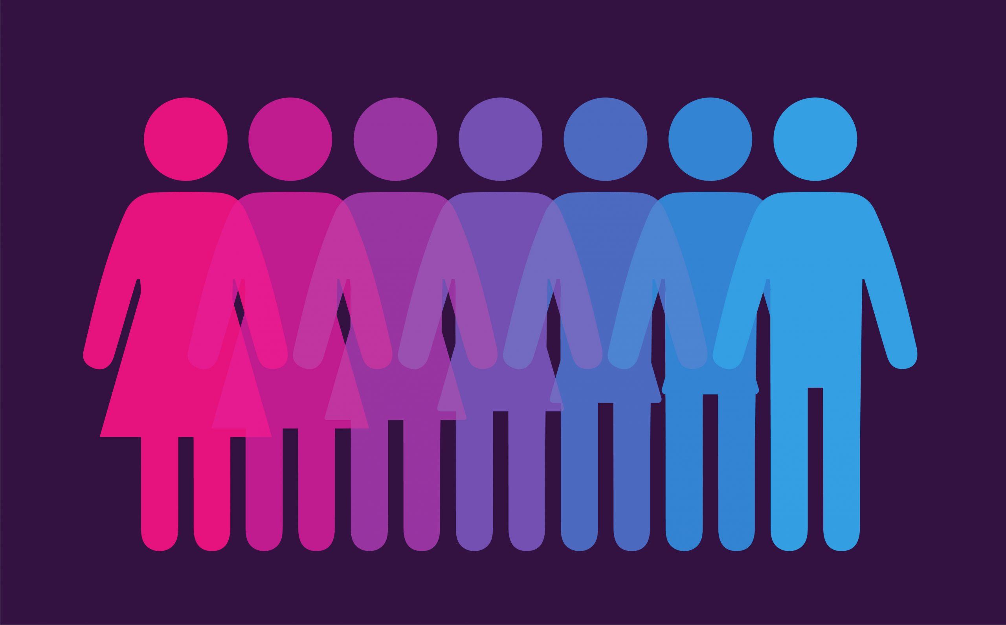
GENDER

Slide 2
Lesson title: Sex and Gender
Split your piece of paper down the middle – write ‘sex at the top of one half and ‘gender’ at the top of the other.
In pairs, try and define these terms.
Are they the same thing?
If not, how are they different?

Slide 3
Notes
https://www.youtube.com/watch?v=NpYlE_EjX9M
Sex and gender are separate concepts.
Sex: biological status as male or female (NATURE).
Determined by different chromosomes which influence hormonal differences in anatomy; reproductive organs, body shape, hair growth etc.
Innate; you cannot change your sex despite surgery…hence it is called gender reassignment surgery.
Gender: a person’s physiological status as masculine or feminine (NURTURE).
Includes attitudes, roles and behaviours associated with said gender.
Heavily influenced by social norms and cultural expectations.
Gender is more fluid and open to change.
Gender identity disorder: biological sex does not reflect the gender they identify with.
Individuals may choose to have gender reassignment surgery.

Slide 4
We raised our baby gender-neutral
https://www.youtube.com/watch?v=HBSgni6m1PI
Read the accompanying article and discuss these questions with the person next to you.
1. What might be the potential benefits and issues of raising a baby gender-neutral?
2. To what extent do you agree with the idea that a child’s gender ‘shapes’ the kind of person they become’?

Slide 5
Would you instinctively attribute these behaviours to men or women?
Taking out the bins
Changing a tyre
Bad driver
Crying at a sad film
Ironing the clothes
Earns more money
Cooking dinner
Doing the food shopping

Slide 6
Notes
Sex-role stereotypes: a set of beliefs and preconceived ideas about what is expected or appropriate for males and females in a given society.
Communicated throughout society.
Agents of socialisation: parents, peers, the media.
Furnham and Farragher (2000); studied TV adverts and found men – professional contexts, women – domestic settings.
https://www.youtube.com/watch?v=_-OAIAhBiHc

Slide 7
Task
Look at the advert you have been given.
How does it reinforce sex-role stereotypes?
Is advertising different today??

Slide 8
Women are better at multi-tasking
True or false?

Slide 9
Women are better at multi-tasking
Outline evidence (page 149) that supports this statement.
What does this tell us about sex-role stereotypes?

Slide 10
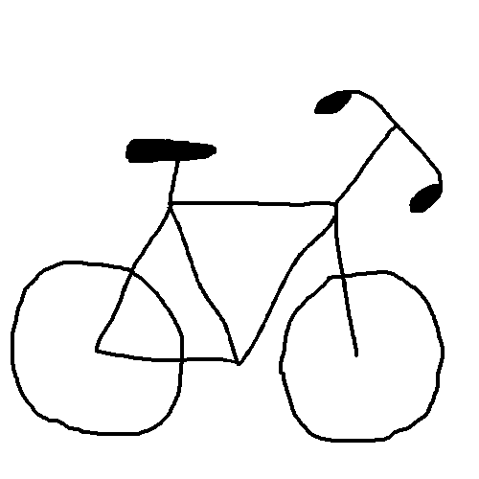
Child of our time: Brain sex
https://www.youtube.com/watch?v=Vp3Kvl7BF0w

Slide 11
Practice exam questions
5 minutes
Using an example, explain the term sex-role stereotype. [3 marks]
Distinguish between sex and gender. [3 marks]

Slide 12
Model answers
Sex-role stereotype refers to a set of beliefs about what is expected for males and females, in a given society. For example, jobs such as taking out the bins and changing a tyre are generally identified as being a ‘male’ job and preparing food is considered a job for a woman.
Sex is the biological differences between males and females including chromosomes hormones and anatomy (arguably fixed) whereas gender refers to the physiological and cultural differences between males and females, for example behaviours and social roles. It is more fluid.

Slide 13
Task
Read the BBC article ‘Do children's toys influence their career choices?’ and answer the accompanying questions.

