Slide 1
Lesson title: Offender profiling: The top-down approach
OPGS Psychology Taster Lessons
Topic: Forensic Psychology
Session 2

Slide 2
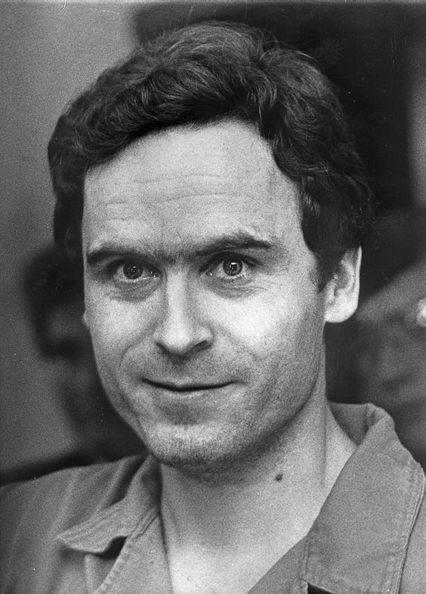
Ted Bundy…
Who was he, what was he accused of?

Slide 3
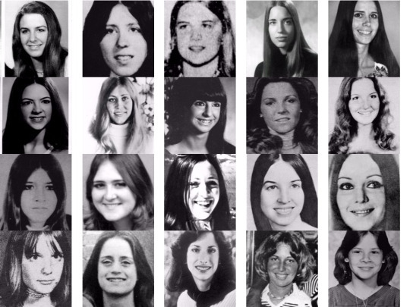
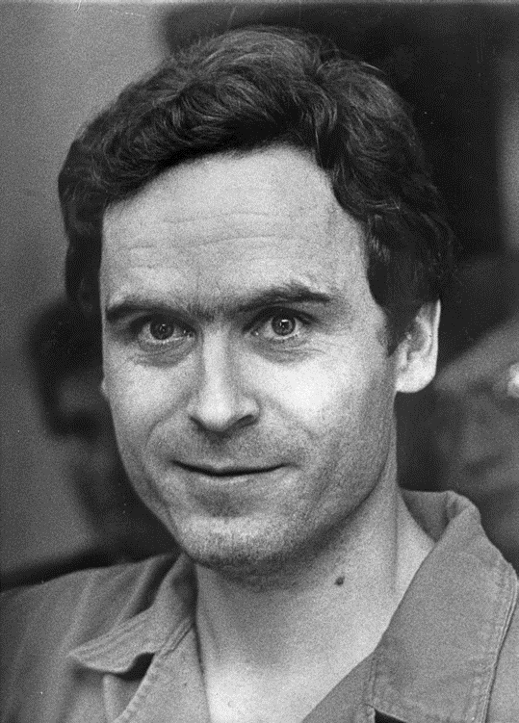
Ted Bundy is one of America’s most notorious serial killers. During the 70’s, he raped, tortured and brutally murdered over 30 women.
Looking at the images below of some of his victims, what conclusions could you draw about the type of women he chose?

Slide 4
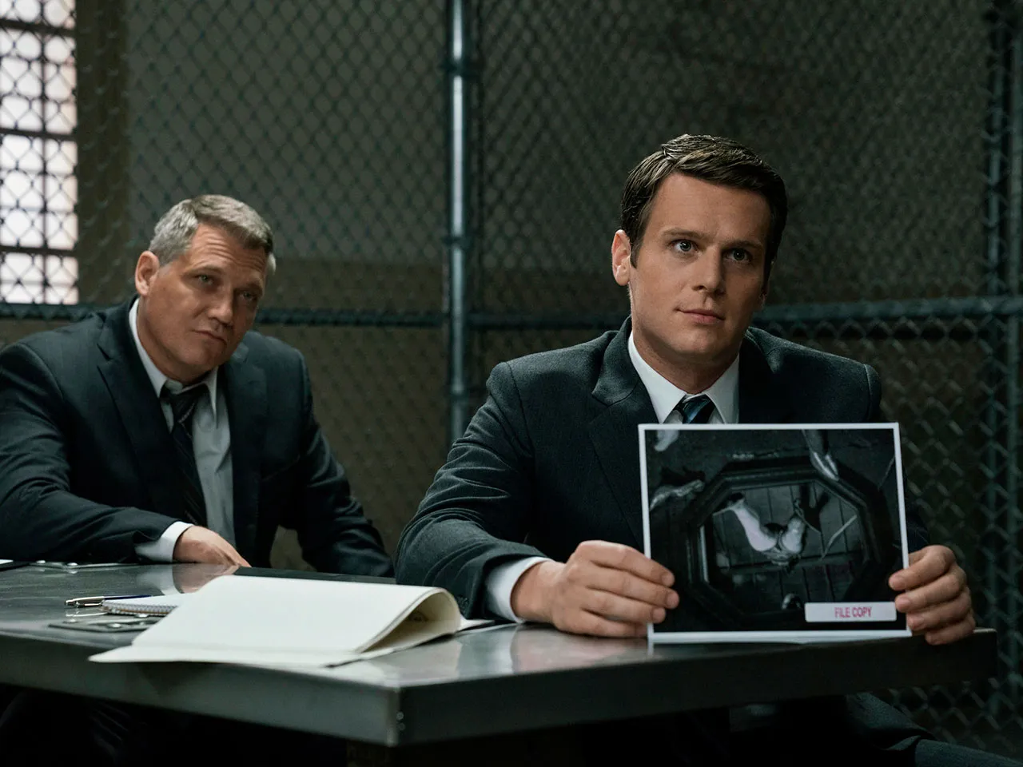
The top-down approach
Offender profiling: a behavioural and analytical tool that is intended to help investigators accurately predict and profile the characteristics of unknown criminals.
Established in America in the 1970’s, FBI’s Behavioural Science Unit.
Collected data from interviews with 36 serial killers.
Known as the typology approach – profilers match what is known about the crime & offender to pre-existing template.
Murderers or rapists classified as ‘organised’ or ‘disorganised’.

Slide 5
The top-down approach
Stages of constructing an FBI profile:
Data assimilation: profiler reviews evidence (crime scene photos, pathology reports).
Crime scene classification: organised or disorganised.
Crime reconstruction: hypotheses in terms of sequence of events and behaviour of victim etc.
Profile generation: hypotheses related to likely offender; demographic background, physical characteristics, behaviour etc.

Slide 6
Organised or disorganised?
Read page 322.
Complete the table below, noting the differences between an organised and disorganised offender:
Organised | Disorganised
Notes:
12.2

Slide 7
Organised or disorganised 1
Between 1986 and 1988, seven attacks on elderly women took place in tower blocks in Birmingham. Women in their 70’s and 80’s, often infirm, were followed into the lifts by a stocky young man who took them to the top floor of the tower block.
He would rape the women and then flee. Consistent patterns seemed to suggest the same man was responsible. In his interactions with the women, he appeared confident and at ease. He made no attempt to disguise himself and forensic evidence was found on each occasion.
Police eventually arrested Adrian Babb, an attendant at the local swimming pool to which all of Babb’s victims were regular visitors.
In pairs discuss: is this case organised or disorganised? Be ready to feedback

Slide 8
Organised or disorganised 2
A teenage victim was attacked in the morning on a secluded path that is very rarely used. She was seized from behind, dragged into some nearby bushes, gaged and bound in duct tape and sexually assaulted.
The path cannot be seen from nearby roads and can only be accessed from an estate on one side.
The victim had unexpectedly spent the night at a friend's house and had not uses the path before.
In pairs discuss: is this case organised or disorganised? Be ready to feedback.
How do both cases illustrate some of the problems with the top-down approach to offender profiling?

Slide 9
So which is Ted Bundy?
Theodore Robert ‘Ted’ Bundy is one of the USA’s most notorious serial killers. During the 1970s, Bundy is known to have raped, tortured and brutally murdered over 30 women (though the actual figure may be much higher) across seven US states.
Handsome, charming and highly intelligent – traits he used to win the trust of his victims – Bundy attended the university of Washington and later, law school, where he excelled. While a student, Bundy fell in love with a wealthy young woman from California. Devastated by their subsequent break up, many of Bundy’s victims resembled his college girlfriend, they were attractive students with long, dark hair parted in the middle. His killings usually followed a gruesome pattern. He often raped his victims before beating them to death.
After escaping police custody twice, Bundy was executed by electric chair in 1989.
Which type of offender does Bundy fit the profile of and why? Organised or disorganised?

Slide 10
Could you be a criminal profiler for the FBI?
Given the evidence provided, your task is to draw up a profile of the offender.

Slide 11
How did you do!?
A white man.
Aged between 25 and 35 years - similar in age to the victim.
Sexual fantasies have been harboured by the offender for a long time and possibly uses and collects sadistic pornography.
He would fit into the context well - might reside in the apartment block or work there.
Average intelligence but dropped out of education.
No military background.
Possibly unemployed.
Unskilled or skilled occupation.
Alcohol and drugs would not have materially contributed.
Difficulties in personal relationships with women.
Any dates would be younger so that they could be more easily controlled and dominated.
Sexually inexperienced and inadequate.
Never married.
Disorganised offender - confused and perhaps mental difficulties in the past.
Messages challenged the police and may indicate future killings.
Using this profile the FBI were able to work through their records and identify a man whose father lived in the same apartment block. The police had been told that his son was in a mental hospital but they found that security there was poor. The crucial piece of evidence was the bite marks on the body which matched the dental pattern of the suspect.

