Slide 1
Forensic Psychology
OPGS Psychology Taster Day 2023
Session 1

Slide 2
Can we successfully, scientifically predict if someone will be a criminal or not?

Slide 3
Measuring ‘riskiness’
We can measure ‘riskiness’ indirectly by presenting individuals with the following dilemma…

Slide 4
Risk-taker Scenario
You are married with one child. You have been working for a large company for five years. You are assured of a lifetime job with a modest salary & a reasonable pension. However, it is very unlikely that this salary will increase much before you retire. You have recently been offered a job with a small, newly established company with an uncertain future. The new job would pay more to start & would offer the possibility of a share in the ownership if the company does well.
Adapted from Choice Dilemmas Questionnaire – Kogan & Wallach, 1964)

Slide 5
Risk-taker Scenario
What would be the lowest probability of the company doing well that you would accept before taking the job? Write your answer as a percentage on the post-it note provided.
Adapted from Choice Dilemmas Questionnaire – Kogan & Wallach, 1964)

Slide 6
Psychometrics
Answering as honestly as possible, remembering there are no right or wrong answers & without sharing your scores, complete the two questionnaires you have been given:
Are you a risk taker?
The Big Five Personality Test

Slide 7
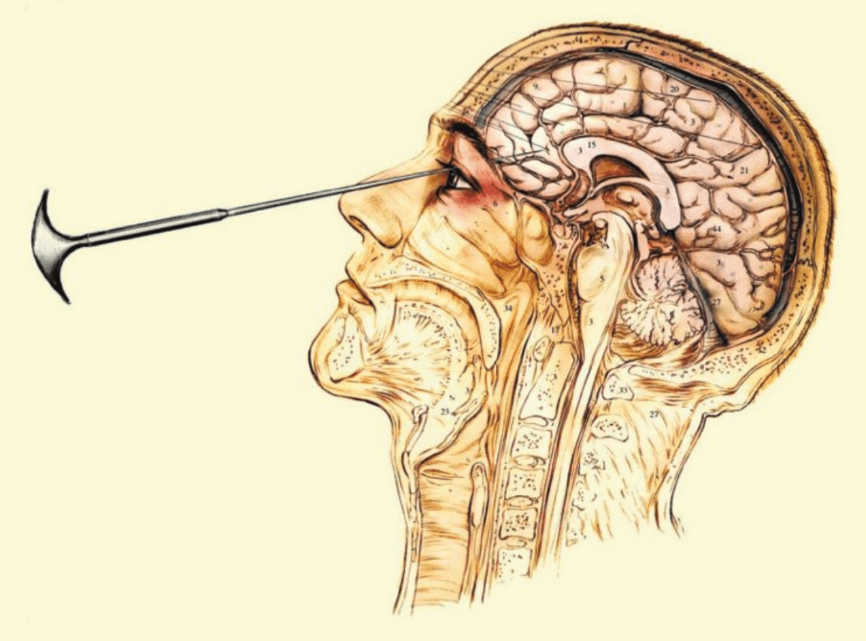
Assessing your results
In pairs, swap your post-it note & questionnaires.
Score each other’s two questionnaires.
Look at:
The percentage from the scenario
The risk taker score
Extraversion (E) & Neuroticism (N) score on the Big Five questionnaire

Slide 8
Assessing your results
Does your partner have a low percentage for the scenario (i.e. less than 50%)?
Does your partner have a high risk taker score (i.e. more than 30)?
Does your partner score high on both Extraversion & Neuroticism (i.e. higher than the mean presented in the graph)?
5 minutes to discuss the results with your partner

Slide 9
Eysenck’s theory of the criminal personality
Eysenck (1974) proposed behaviour could be represented along two dimensions;
Introversion/extroversion
Neuroticism/stability
The two combine to form a variety of personality characteristics (traits).
He later added a third dimension, psychoticism.

Slide 10
Biological basis
Eysenck believed personality traits were biological in origin – result of the nervous system we inherited. I.e. all personality types (including criminal personality) have an innate, biological basis.
Extraverts have an underactive nervous system – they constantly seek excitement, stimulation & are likely to engage in risk-taking behaviour. They are also said not learn from their mistakes.
Neurotic individuals tend to be nervous, jumpy & over-anxious. Their general instability makes their behaviour difficult to predict.

Slide 11
The criminal personality
According to Eysenck, the criminal personality type is neurotic-extravert.
In addition, Eysenck suggested that the typical offender will also score high on measures of psychoticism – a personality type that is often characterised as cold, unemotional & prone to aggression.
He theorised criminal behaviour was developmentally immature, selfish & concerned with immediate gratification.
The nervous system makes it hard for criminals to be conditioned (taught socially acceptable behaviour). Thought of punishment makes most individuals anxious, with criminals this is not the case.

Slide 12
What Factors Influence the Big Five Traits?
Research suggests that both biological & environmental influences play a role in shaping our personalities. Twin studies suggest that both nature & nurture play a role in the development of each of the five personality factors.﻿
One study of the genetic & environmental underpinnings of the five traits looked at 123 pairs of identical twins & 127 pairs of fraternal twins. The findings suggested that the heritability of each trait was 53% for extraversion, 41& for agreeableness, 44% for conscientiousness, 41% for neuroticism, & 61% for openness.

Slide 13
What Factors Influence the Big Five Traits?
Longitudinal studies also suggest that these big five personality traits tend to be relatively stable over the course of adulthood. One study of working-age adults found that personality tended to be stable over a 4-year period & displayed little change as a result of adverse life events.
Studies have shown that maturation may have an impact on the five traits. As people age, they tend to become less extraverted, less neurotic, & less open to experience. Agreeableness & conscientiousness, on the other hand, tend to increase as people grow older.

Slide 14
What about us teenagers?
Gullone & Moore (2000) found:
Younger adolescents & girls generally reported engaging in risk behaviours less frequently than older adolescents & boys.
Younger adolescents & girls generally rated the Adolescent Risk Questionnaire (ARQ) behaviours as riskier than their older male counterparts.
Significant negative correlations found between risk judgements & risk behaviours of all types.
Few age differences were found for the personality traits.
Sex differences were evident, with female adolescents scoring higher on neuroticism, agreeableness & conscientiousness than male adolescents.

Slide 15
What about us teenagers?
Gullone & Moore’s (2000) summary findings were:
Together, risk judgements, personality factors, age & sex were found to be significant predictors of risk behaviours
However, the personality factor of significance was found to differ depending upon the risk type.
This was also true for age & sex which differed in importance depending upon the risk type.
Overall, these factors were most successful in predicting rebellious risk-taking & least successful in predicting thrill-seeking.

Slide 16
Questions?
Take home information:
Psychometrics
The Big Five personality traits explained booklet
Personality Profile of Risk Takers article

Slide 17
Take home information
Scenario – post-it note!
Risk taker psychometric
Big 5 psychometric
Slides

