Slide 1
Digital World 8
Gender

Slide 2
Notes
Use the New Digital World Resource p24-26 to make notes on the Gender Digital divide.

Slide 3
Task 15: Gender and the Digital Social World:
You will need to collect information and examples on the positives and negatives of the digital world on our gender identities.
I have included some resources on the next few slides.
I have marked them Basic, Medium or Advanced
You must make notes all the compulsory ones.
Then choose 2 others from any category. Advanced does not necessarily mean long, by the way.

Slide 4
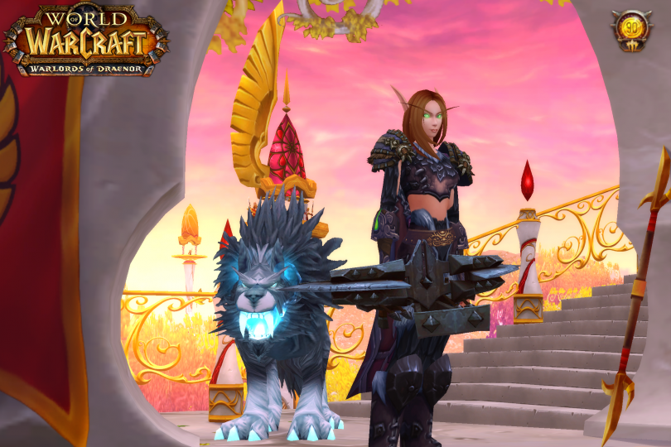
http://www.ibtimes.com/female-wow-players-tell-all-what-world-warcraft-really-them-1999879 Basic

Slide 5
Women should hide their gender
http://uk.businessinsider.com/john-greathouse-rincon-venture-partners-vc-op-ed-2016-9?r=US&IR=T Basic

Slide 6
Reclaiming the Nerdiverse -
http://www.bbc.co.uk/programmes/b064zqyw Medium but long, It is a programme.

Slide 7
Women and public space
https://www.theguardian.com/commentisfree/2017/aug/07/silicon-valley-weapon-choice-women-google-manifesto-gender-difference-eugenics?CMP=share_btn_tw Advanced
https://twitter.com/EA/status/911337494070693888/photo/1 Basic (profane language)
https://www.theguardian.com/society/2019/jan/04/depression-in-girls-linked-to-higher-use-of-social-media?CMP=Share_iOSApp_Other Medium Compulsory
https://www.technologyreview.com/s/608216/twitters-glass-ceiling-revealed-for-women-and-minority-races/?set= Compulsory

Slide 8
Researching users of the Digital World
What is the view of this article regarding the creation of social equality via the digital world? Advanced
https://journals.sagepub.com/doi/10.1177/1461444818820069 last paragraph sums it up

Slide 9
Gender and The Digital World
http://journals.plos.org/plosone/article?id=10.1371/journal.pone.0131613 Advanced (but super interesting especially if you are a gamer who loses a lot.)
https://www.bbc.co.uk/programmes/w3cswqvc (did #metoo change anything? ) COMPULSORY

