Slide 1
A-Level Drama & Theatre
2022-2023

Slide 2
Learning Outcomes
By the end of this lesson I will have:
All: Understood the course content and outline.
Most: Understand various view points that theatre is a vehicle for promoting issues in today’s society.
Some: That theatre is a catalyst for engaging and prompting a reaction.

Slide 3
Course Outline
All: Understood the course content and outline.
Most: Understand various view points that theatre is a vehicle for promoting issues in today’s society.
Some: That theatre is a catalyst for engaging and prompting a reaction.
The A-Level is split into 3 Components over 2 years.
Component 1: Devising
Coursework: 40% of the qualification 80 marks
Content overview: Devise an original performance piece Use one key extract from a performance text and a theatre practitioner as stimuli
Assessment: Written portfolio – 2500 – 3000 Devised performance
Component 2: Text in Performance
Coursework: 20% of the qualification 60 marks
Content overview: A group performance of one key extract from a performance text. A monologue/duologue performance from one key extract from a different performance text.
Assessment: Externally assessed by a visiting examiner Group performance worth: 36 marks Monologue/Duologue worth: 24 marks

Slide 4
Course Outline
All: Understood the course content and outline.
Most: Understand various view points that theatre is a vehicle for promoting issues in today’s society.
Some: That theatre is a catalyst for engaging and prompting a reaction.
The A-Level is split into 3 Components over 2 years.
Component 3: Theatre Makers in Practice
Written Examination: 2 hours 30 minutes 40% of the qualification 80 marks
Content overview: Live theatre evaluation Practical exploration & study of a complete performance text – focussing on how this can be realised for performance. Practical exploration & interpretation of another complete performance text, in light of a chosen theatre practitioner – focussing on how this could be reimagined for a contemporary audience.
Assessment: Section A: Live Theatre Evaluation Section B: Page to Stage: Realising a Performance Text Section C: Interpreting a Performance Text

Slide 5
ARGUMENTS FOR A THEATRE
Theatre is merely recreation, entertainment.
So above all it should entertain?
Discuss this statement in pairs
2 minutes!

Slide 6
What is Theatre For?
Task 1:
In groups of 3 (ish!)
You are to look at the statements on the pink cards and discuss.
All: Understood the course content and outline.
Most: Understand various view points that theatre is a vehicle for promoting issues in today’s society.
Some: That theatre is a catalyst for engaging and prompting a reaction.
Historical influences
Through this induction you will devise your own mission statement and philosophy for Theatre.
You will study the work of various influential practitioners in theatre and how their ideals have changed what theatre stands for.
Social factors influencing the theatre (class)
Economical Factors
Task 2:
Discuss and mind map in your groups the use of theatre.
Form your discussion by commenting on:
Why study / perform drama
Cultural factors

Slide 7
Theatre Practitioners!
What theatre practitioners have you studied before?

Slide 8
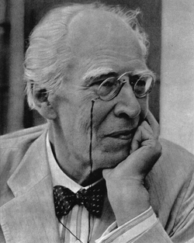
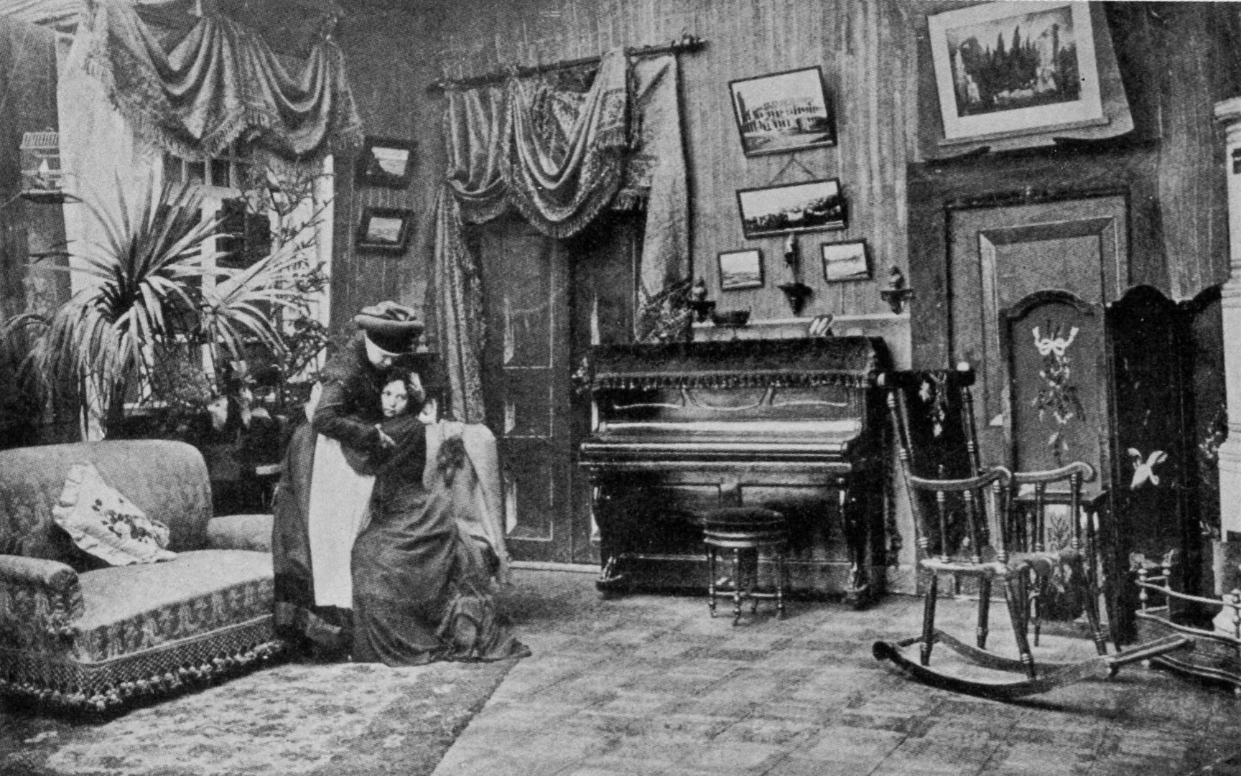
Stanislavski
The Acting System
Work from the inside out
Become the character
Given
Circumstances
Elaborate/ Life Like Sets
The Magic IF
Pre- Curtain
History

Slide 9
Learning Objectives
By the end of the lesson you will have learnt:
Stanislavski’s main theory was naturalism and realistic acting; becoming the character.
Stanislavski's system was called 'method acting'.
Stanislavski was one of the most influential practitioners of all times. He did not write plays and therefore the question must be raised – were his ideas less informed because of this?

Slide 10
Konstantin Stanislavski
Learning Objectives
Stanislavski’s main theory was naturalism and realistic acting; becoming the character.
Stanislavski's system was called 'method acting'.
Stanislavski was one of the most influential practitioners of all times. He did not write plays and therefore the question must be raised – were his ideas less informed because of this?
1863 – 1938
Born in Russia
Considered to be the ‘father’ of modern theatre.
He provided a rehearsal system that allowed actors to create characters in which they – and the audience – could believe.
Before Stanislavski theatre focussed on melodrama and relied on stock characters – Stanislavski didn’t like this.
1897 – Stanislavski co-founded Moscow Art Theatre – the style of acting had to be: clear, sensitive, detailed and truthful.
Stanislavski didn’t write plays. He wasn’t a playwright but he did write books: ‘An Actor Prepares’, ‘Building a Character’ and ‘Creating a Role’.
Unlike his contemporaries, Stanislavski placed real emphasis on the importance of the REHEARSAL.
The actors needed to explore the characters and the performances needed to be organic.
Exercises became an essential element of an actor’s training.
REALISM

Slide 11
Stanislavski’s System…
Learning Objectives
Stanislavski’s main theory was naturalism and realistic acting; becoming the character.
Stanislavski's system was called 'method acting'.
Stanislavski was one of the most influential practitioners of all times. He did not write plays and therefore the question must be raised – were his ideas less informed because of this?
Emotional Memory
Actors are required to explore their own living experience in order to find equivalents for the feelings experienced by their characters, discovering feelings which are shared with the character.
The Given Circumstance
What is taken as ‘true’ in the context of the play; time, space, relationships. This was a way of preventing his actors from relying on stock characters. He expected his actors to explore the given circumstance.
Magic If
The Magic If encouraged actors to believe in circumstances no matter how fantastic they may have been.
The actor needs to ask him or herself the question: “If I were this person, how would I feel?”
This ensures each role is deeply rooted in the facts of the play.

Slide 12
Stanislavski’s System…
Learning Objectives
Stanislavski’s main theory was naturalism and realistic acting; becoming the character.
Stanislavski's system was called 'method acting'.
Stanislavski was one of the most influential practitioners of all times. He did not write plays and therefore the question must be raised – were his ideas less informed because of this?
Super Objective
The ‘Super Objective’ is the objective for the character for the whole play!
It is the main theme for them and everything drives towards the super objective – their final goal in the play For example: a character’s super objective might be to have completed something or have a partner etc…
Subtext
Subtext is the underlying meaning in text “Read between the lines!” It is NOT spoken but interpreted by the actor through posture, gesture, expression & body language etc…
Concentration & Relaxation
Stanislavski believed it to be highly important that actors were relaxed so not to get nervous (a ‘controlled body and mind’) but also to concentrate on what was going on…
CIRCLES OF ATTENTION – like a personal space bubble!

Slide 13
Exercise 1 - Relaxation
Learning Objectives
Stanislavski’s main theory was naturalism and realistic acting; becoming the character.
Stanislavski's system was called 'method acting'.
Stanislavski was one of the most influential practitioners of all times. He did not write plays and therefore the question must be raised – were his ideas less informed because of this?
Breathing
Light
Connection
Free Mind
Focus
Body
Heavy
Imagine that you are an artist. You have just been away to the beach for inspiration and you are back in the studio.
Imagine the easel in front of you and the paintbrush in your hand. You are going to paint from memory the landscape you observed.
Your objective is ‘I want to do my best’
Your action is ‘I enjoy’
What is it like using your imagination and how will you stay focussed?

Slide 14
Exercise 2 – Relaxation cont.
Learning Objectives
Stanislavski’s main theory was naturalism and realistic acting; becoming the character.
Stanislavski's system was called 'method acting'.
Stanislavski was one of the most influential practitioners of all times. He did not write plays and therefore the question must be raised – were his ideas less informed because of this?
Breathe Out
MIND
Instructions:
Now lie on the floor
Lie on your back
Place your legs shoulder width apart
Arms down by your side
Palms facing up
Spine and neck are in a straight line
Close your eyes
Listen!
Breathe In
Breathe Out
Breathe In
Toes
Feet
Knees
Ankles
Calves
Thighs
Hips
Stomach
Spine
Chest
Lower Back
Upper Back
Elbows
Lower Arms
Hands
Fingers
Neck
Face
Eyes
Cheeks
Mouth

Slide 15
Relaxation…
Learning Objectives
Stanislavski’s main theory was naturalism and realistic acting; becoming the character.
Stanislavski's system was called 'method acting'.
Stanislavski was one of the most influential practitioners of all times. He did not write plays and therefore the question must be raised – were his ideas less informed because of this?
Reflection:
Was there a difference between the first and last time you did the exercise?
If so, what was the difference?
Did the relaxation help you to imagine the activity the second time?
How did the relaxation make you feel?
Slowly stand up
Return to your chair
Imagine you are the artist again
Imagine that you are an artist. You have just been away to the beach for inspiration and you are back in the studio.
Imagine the easel in front of you and the paintbrush in your hand. You are going to paint from memory the landscape you observed.
Your objective is ‘I want to do my best’
Your action is ‘I enjoy’
What is it like using your imagination and how will you stay focussed?

Slide 16
Space Filling/Movement/Observation
IMAGINATION
Copy your partners walk.
Focus on re-creating the walk honestly – Do not exaggerate.
Beginning to create a character and a role.
NOTE TAKING:
How did you feel completing that exercise?
What did you have to do?
What were the difficulties with that activity, if there were any?
Learning Objectives
Stanislavski’s main theory was naturalism and realistic acting; becoming the character.
Stanislavski's system was called 'method acting'.
Stanislavski was one of the most influential practitioners of all times. He did not write plays and therefore the question must be raised – were his ideas less informed because of this?
Walk around the room finding the space.
DO NOT make physical contact with anyone.
Pair up
Observe each other walking
What are their traits?
What are they thinking?
What is their mood?
Think about:
How easy was it?
How effective were you at filling the gaps?
How did you walk?
Notes:
Middle: STOP. Change Focus

Slide 17
Learning Objectives
By the end of the lesson you will have learnt:
To continue my understanding of Stanislavski’s system
Recall on my own memories and emotions to develop character.
Evaluate the effectiveness of Stanislavski’s system.

Slide 18
Emotion Memory
Learning Objectives
To continue my understanding of Stanislavski’s system
Recall on my own memories and emotions to develop character.
Evaluate the effectiveness of Stanislavski’s system/
You have 4 minutes to share!!
Think back over a time when you may have felt fear. (It could have been when you’d done something wrong and thought you’d been found out, or it may have been when you were somewhere where you shouldn’t be!)
In pairs, describe your memories to each other, try to remember what you were thinking at the time and how you felt about it.
Don’t choose something too personal. This isn’t about you choosing your most inner thoughts but describing a MEMORY!

Slide 19
The following extract is taken from A Doll’s House, Henrick Ibsen.
Read in pairs & discuss!
Learning Objectives
To continue my understanding of Stanislavski’s system
Recall on my own memories and emotions to develop character.
Evaluate the effectiveness of Stanislavski’s system/
Emotion Memory – Using Script
Nora In the letterbox! (she creeps stealthily across to the hall door) There it is! Torvald, Torvald! It’s hopless now!
Mrs Linde (comes into the room, left, carrying a costume) There, I think that’s everything. Shall we try it on?
Nora (in a low, hoarse whisper) Kristine, come here.
Mrs Linde (throws the dress down on the sofa) What’s wrong with you? You look upset.
Nora Come here. Do you see that letter? There, look! Through the glass in the letter box.
Mrs Linde Yes, yes I can see it.
Nora It’s a letter from Krogstad.
Mrs Linde Nora! It was Krogstad who lent you the money!
Nora Yes. And now Torvald will get to know everything.
Mrs Linde Believe me, Nora, it’s best for you both.
Nora But there’s more to it than that. I forged a signature…
Mrs Linde Heavens above!
What do you think is happening in this extract?
Krogstad has left a letter addressed to Nora’s husband in the locked letter box.
Information damaging to Nora is in the letter, and only her husband has a key.
Nora knows that when her husband opens the letter box, he will find the letter and discover that Nora had borrowed money by forging the signature of her father!

Slide 20
Draw on your own emotions…
Hot Seating
Now that you have some understanding of your character, either Nora or Mrs Linde we are going to Hot Seat them individually.
Use the emotion of fear, for Nora.
Think about how you could bring in your own emotion for Mrs Linde. What would it be and why?
Learning Objectives
To continue my understanding of Stanislavski’s system
Recall on my own memories and emotions to develop character.
Evaluate the effectiveness of Stanislavski’s system/
Perform & Evaluate
What did you observe in their performance?
Could you tell that the emotions were real? How?
How did you feel using your own emotions to embody the character of Nora?
Do you think this was an effective tool to emotionally connect with the character?
Continuing in pairs
Improvise the scene.
Drawing on your own memories of fear to understand how Nora felt within these circumstances.
Use the feeling from your memories as in a way into how Nora may have been feeling.

Slide 21
Given Circumstance
Learning Objectives
To continue my understanding of Stanislavski’s system
Recall on my own memories and emotions to develop character.
Evaluate the effectiveness of Stanislavski’s system/
Objective
What we, as the character want to achieve within a given set of circumstances.
The situation the character is in within a particular bit of the play/performance.

Slide 22
Objectives
Learning Objectives
To continue my understanding of Stanislavski’s system
Recall on my own memories and emotions to develop character.
Evaluate the effectiveness of Stanislavski’s system/
Scenario 1:
Your train was delayed and you are already 5 minutes late for your job interview. This is your first interview since leaving university, and you have been getting more and more worked up on the train. You had planned to take a bus to the interview but now decide to hail a cab. You are now really nervous and stressed & need to calm down.
OBJECTIVE: I want to calm myself down.
Scenario 2:
You are an American businesses man and have arrived at Bangkok International Airport. You have to get to Phom Prong for a meeting. You have no idea where you are going so you have decided to get a taxi. This is your first time in Thailand.
OBJECTIVE: I want to orientate.
What was the purpose of this activity?
What has it made you understand about a character’s objective?
What has it allowed you to understand about the given circumstance?
In pairs – A & B
Use 4 chairs to represent a taxi and start the improvisations with the driver already sitting in the front of the cab.
Student A:
You are the taxi driver, it is midday, and you’ve been working since 7 o’clock this morning.
You are waiting outside Liverpool Street station. You generally ask a few questions of people in your cab, to get a conversation going; it usually helps to pass the time.
Your objective is: ‘I want to belong’.
Student B:
You will choose a given circumstance and an objective from the scenarios
You will hail the taxi and get in.
Use the given circumstance to feed into your objective and imagine how you are going to achieve your objective.
Scenario 3:
You want to be a singer; you left school last year after your GCSE’s to concentrate on singing. You have just auditioned for a local celebrity singing manager Michael Goldman and he said you were ‘special’. You have phoned everyone you know and now are desperate to tell the cab driver all about today.
OBJECTIVE: I want to share my good news.
You will do this exercise three times, each with a different given circumstance and objective, so that you can start to see how having a different objective affects the outcome of the improvisation

Slide 23
Truth & Belief
Learning Objectives
To continue my understanding of Stanislavski’s system
Recall on my own memories and emotions to develop character.
Evaluate the effectiveness of Stanislavski’s system/
Activity 2:
I have placed 1000 Baht in the room.
It is your job to go and find it!!
If found you get to keep it!!!!!
Now you must repeat the exercise, but without the money.
How different was it to recreate the same atmosphere in the room without a reason for doing it?
Need the character’s motivation, linked with imagination, in order to create truth and belief onstage.
Activity 1:
In partners, A and B.
A has to tell B a story about themselves- it needs to be a story that others in the class do not know about!!
B has to learn that story, and re-tell it as their own.
A and B have to both tell that story to the class, and others have to guess whose story it actually is.
Discuss what made each person sound ‘truthful’ and why we did/did not ‘believe’ them.

Slide 24
Magic If – what if?
Learning Objectives
To continue my understanding of Stanislavski’s system
Recall on my own memories and emotions to develop character.
Evaluate the effectiveness of Stanislavski’s system/
1 volunteer to act as though they are walking down the street.
Others to ask... “What if...”
“What if you were attacked by an old lady”.
REALISTIC AS POSSIBLE!!!

Slide 25
Magic If
Learning Objectives
To continue my understanding of Stanislavski’s system
Recall on my own memories and emotions to develop character.
Evaluate the effectiveness of Stanislavski’s system/
Sit on a chair in your own in the space.
React ‘naturally’ to the situations that are called out.
You are on a rollercoaster riding to the top;
what if you let go?
You are in an interview room for a job you really want/not bothered about;
what if they offer you the job there and then?
You are waiting for test results;
what if it’s bad news?
You are sitting in the park eating your lunch;
what if someone comes along and steals it?
You sit on the chair, and there is something sticky on it;
what if it wont come off?

Slide 26
Stanislavski Recap
Who was Konstantin Stanislavski?
What did he believe about theatre?
As an actor what main skills and or techniques did Stanislavski want his actors to do?
How and when would you use Stanislavski’s system in your own practical work?

Slide 27
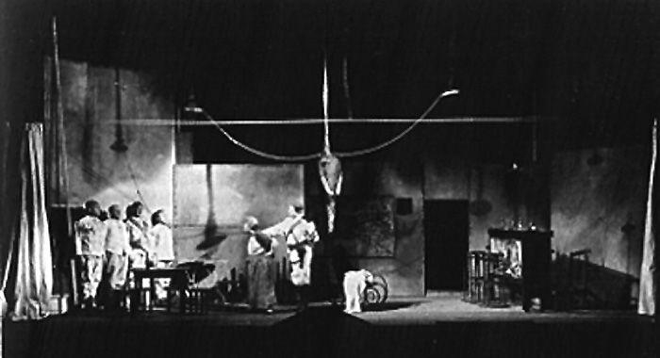
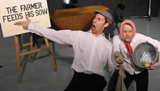
BERTOLT BRECHT
Placards
Alienation
Affect
Live Instruments used on stage
Gestus
Song
Minimalistic Set

Slide 28
Learning Objectives
By the end of the lesson you will have learnt:
Understand how to use Brecht’s theories to adapt the meaning of performance.
Explore through the use of improvisation how to experiment with Brechtian techniques.
Evaluate the differences between Stanislavski and Brecht.

Slide 29
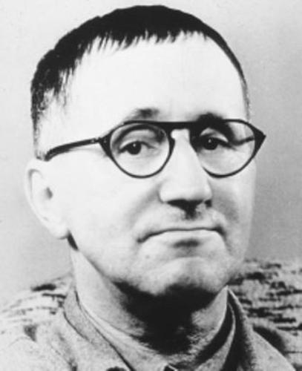
Learning Objectives
Understand how to use Brecht’s theories to adapt the meaning of performance.
Explore through the use of improvisation how to experiment with Brechtian techniques.
Evaluate the differences between Stanislavski and Brecht.
Bertolt Brecht
Brecht alienated the audience by using the Verfremdungseffkt.
Brecht didn’t want them to feel any emotion.
1933 forced to exile and escape Nazi’s because of his political plays.
Brecht’s primary aim: creating a political theatre that communicates and educates its audience.
Brecht’s work and ideas were deeply influenced by the social, political and cultural events that surrounded him.
The majority of actors that Brecht would have used when working on his plays would have been trained using Stanislavski’s system.
Bertolt Brecht 1898 - 1956
German Theatre Practitioner and Playwright.
He developed a style of theatre called EPIC THEATRE
He disliked Stanislavski’s naturalistic approach to the theatre as it did not provoke thought and suggest change
Brecht wanted the audience to start thinking of solutions to the problems in their society.

Slide 30
OVER EXAGGERATION
MULTIPLE PROPS
PLACARDS
What Actors Would Do…
THIRD PERSON
STAGE DIRECTIONS
BREAKING THE FORTH WALL

Slide 31
EPIC THEATRE
Political
Relates to the government of public affairs and the running of the state.
Learning Objectives
Understand how to use Brecht’s theories to adapt the meaning of performance.
Explore through the use of improvisation how to experiment with Brechtian techniques.
Evaluate the differences between Stanislavski and Brecht.
Focuses upon socio-political issues
Present an argument and make the audience think rather than just simply be entertainment
Brecht believed that within Epic Theatre:
The message should be clear and the audience must be critically aware
It should be un-emotional
We should never pretend that the cast and director are unaware of what is about to happen
Social
Concerns the relationship between people and communities within a country.
WHY?
He wanted his audience to “change the world”. He believed that all too often audiences “hang up their brains with their hats in the cloakroom”
Epic Theatre was didactic. This means it was based on morals and made the audience think.

Slide 32
Learning Objectives
Understand how to use Brecht’s theories to adapt the meaning of performance.
Explore through the use of improvisation how to experiment with Brechtian techniques.
Evaluate the differences between Stanislavski and Brecht.
The actor carefully uses GESTUS to provoke debate and educate the audience.
Brecht was famous for a particular style of acting called GESTUS.
GESTUS?
The combination of gesture and facial expression and body language is deliberately used to create meaning and communicate a message to the audience.

Slide 33
The Narrator - Gestus
Learning Objectives
Understand how to use Brecht’s theories to adapt the meaning of performance.
Explore through the use of improvisation how to experiment with Brechtian techniques.
Evaluate the differences between Stanislavski and Brecht.
Discussion & Feedback:
How did you communicate your nursery rhyme or song to your partner?
When you could not use your voice to communicate, what did you use instead?
Did you feel that you started to use your body and physicality to directly communicate with your partner?
What could have you done differently?
Task 1:
In pairs; A & B
Line up at opposite ends of the classroom.
A’s need to think of a well known nursery rhyme or song.
A’s you will communicate the nursery rhyme or song ONLY through non-verbal communication.
You must not mouth or speak.
B’s you need to guess what nursery rhyme or song they are trying to communicate.
Once you know; raise your hand and guess.
Continuing miming until B guesses correctly.
Swap over!
Did you feel like you were narrating your message?

Slide 34
Defusing a BOMB...!
Learning Objectives
Understand how to use Brecht’s theories to adapt the meaning of performance.
Explore through the use of improvisation how to experiment with Brechtian techniques.
Evaluate the differences between Stanislavski and Brecht.
Two men who have to defuse a bomb.
The piece must be dramatic and naturalistic.
They don’t have the right tools to defuse the bomb.
They think they have successfully defused it, but they have little experience at defusing bombs and it goes off anyway.
Their commanding officer is shouting at them. They don’t have enough time. The bomb goes off.
Reflection
What did you feel?
How drawn in were you by the characters?
How emotionally attached were you?

Slide 35
Defusing a BOMB 2…!
Learning Objectives
Understand how to use Brecht’s theories to adapt the meaning of performance.
Explore through the use of improvisation how to experiment with Brechtian techniques.
Evaluate the differences between Stanislavski and Brecht.
Task 2:
Repeat the same exercise, but this time you must split up your piece into three sections
beginning, middle and end.
each section must have a title, read out by one of the actors.
present your scenes in non chronological order.
what other Brechtian techniques could you use?
Reordering the scenes is called MONTAGE!!!
The literary term ‘epic’ can be applied traditionally to a story made up of a series of ‘episodes’.
Reflection
What did you feel?
How did changing the order make you think about the piece?

Slide 36
Learning Outcomes:
By the end of this lesson you will have:
Thought about how juxtaposing images and sounds can distance the audience and get you to think
Realised that Brecht wanted his audience to be critical observers.

Slide 37
Juxtaposing Images & Sounds
Learning Objectives
Thought about how juxtaposing images and sounds can distance the audience and get you to think
Realised that Brecht wanted his audience to be critical observers.
What effect does it have juxtaposing something so brutal, with something so soft?
How can your audience be distanced from an immediate emotional response to something?
TASK:
In pairs create a slow motion fist-fighting scene in mime – 60 seconds long!
Perform
Repeat this exercise, but this time rehearse with the music.
Think of other Brechtian techniques you could include however, mime is still your primary technique.
Perform
Notes:
‘Somewhere over the Rainbow’ by Israel Kamakawiwo’ole

Slide 38
Personal Reflection…
Learning Objectives
Thought about how juxtaposing images and sounds can distance the audience and get you to think
Realised that Brecht wanted his audience to be critical observers.
On paper answer the following questions based on today’s exploration:
Describe in detail the task you had to complete in today’s lesson.
How did you use Brecht’s theories to communicate your intentions to the audience?
How did the use of juxtaposition allow you develop performance work? Was this effective? Describe why you thought so. Or maybe didn’t think so.
What could have you done differently? Why was this?

Slide 39
The Accident…
Learning Objectives
Thought about how juxtaposing images and sounds can distance the audience and get you to think
Realised that Brecht wanted his audience to be critical observers.
I am not going to talk! For this activity you must read the task in the red box and organise yourselves.
You have 15 minutes worth of planning and rehearsal time!
In 3’s
There has been a road accident, and as a passer-by you have been a spectator to it.
Agree the facts of the story and then each of you work out your version of events.
Show these versions to each other to see how different they can be from varying perspectives
Imagine you are telling the story to a group of people who did not see the accident.
Tell the story and include all of the characters within it.
Feel free to impersonate them or caricature them.
Try to use:
gestus, narration, dialogue and third person, juxtaposition, didactic theatre, descriptions and even token costumes to bring the story to life.

Slide 40
Personal Reflection…
Learning Objectives
Thought about how juxtaposing images and sounds can distance the audience and get you to think
Realised that Brecht wanted his audience to be critical observers.
On paper answer the following questions based on today’s exploration:
Describe in detail the task you had to complete in today’s lesson.
How did you use Brecht’s theories to communicate your intentions to the audience?
How did the use of juxtaposition allow you develop performance work? Was this effective? Describe why you thought so. Or maybe didn’t think so.
What could have you done differently? Why was this?

Slide 41
No Smoking Campaign
Learning Objectives
Thought about how juxtaposing images and sounds can distance the audience and get you to think
Realised that Brecht wanted his audience to be critical observers.
Placards
Multi-Rolling
In groups of 3 or one group of 6
You are to create a silent movie based on the topic of a no smoking campaign.
You piece must be didactic.
Must set the scene; beginning, middle and end.
It must try to include the following Brechtian techniques:
Montage
Gestus
Stage Directions
Juxtaposition
Over Exaggeration
Breaking the Forth Wall
Multiple Props
Token Costumes

Slide 42
Mini BRECHT QUIZ
Who was Brecht?
What did Brecht want his audience to do when they came to see a play?
Name two techniques that Brecht used on his audience.
What is meant by the term ‘direct address’?
What did Brecht want the audience to think about the characters they saw on stage?
How have you actively implemented Brecht’s theories into your performance work?
Describe a technique of Brecht’s you like and why.

Slide 43
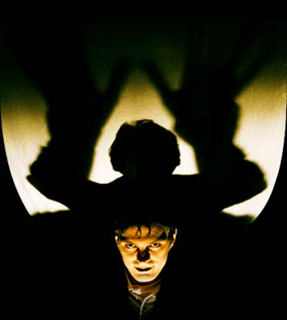
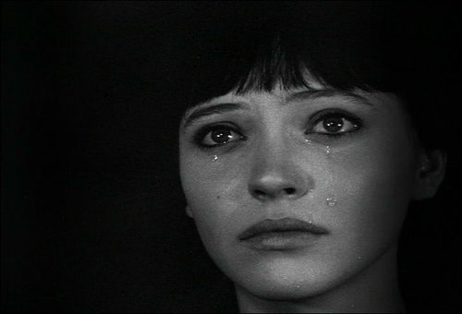
ANTONIN ARTAUD
Attach of the Senses
Theatre of Cruelty
Audience
Intrusion
Animalistic
Instinct
Rhythm and
Ritual

Slide 44
Learning Objectives
Understand the practices of Artaud.
Experiment practically in the style of Artaud.
Evaluate the differences between Stanislavski, Brecht and Artaud.

Slide 45
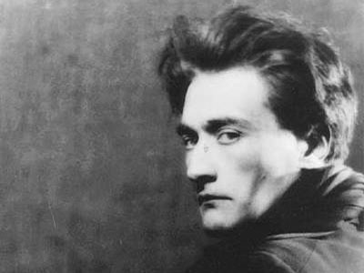
Learning Objectives
Understand the practices of Artaud.
Experiment practically in the style of Artaud.
Evaluate the differences between Stanislavski, Brecht and Artaud.
In the Theatre of Cruelty, he was trying to revolutionise theatre.
Artaud believed that all people were savages with secret desires to commit outrages.
He believed that by containing these themes and desires within theatre, living them with and through the actors, the audience would not act on them.
Artaud wanted to push his actors and audience to the extreme. He believed that the actor needed to use themselves physically beyond what the comfort zones
Artaud believed in a universal language, in which everyone could understand and engage. This could include screams, grunts, sighs and breaths.
Antonin Artaud
(1896 – 1948)
Was a French playwright, poet, actor and director.
He suffered with mental illness and drug addiction throughout his life.
He was not realised as an influential practitioner during his own lifetime.
His most famous theory is the ‘Theatre of Cruelty’
Artaud thought that society and the world of theatre had become an empty shell. extremes.

Slide 46
Learning Objectives
Understand the practices of Artaud.
Experiment practically in the style of Artaud.
Evaluate the differences between Stanislavski, Brecht and Artaud.
Antonin Artaud
Physicality is taken to the extreme, but not ‘over-acted’ or melodramatic.
Without Artaud, there would, arguably, be no physical theatre
The actor/audience relationship is key in Artaud’s theory.
Artaud envisioned the audience on swirling chairs so that they can engage with the actor at all angles.

Slide 47
Learning Objectives
Understand the practices of Artaud.
Experiment practically in the style of Artaud.
Evaluate the differences between Stanislavski, Brecht and Artaud.
Whilst watching consider the following questions:
What do you think Artaud is wanting to convey through his performance of ‘A Jet of Blood’.
Is it intended to put the audience on edge or to make them question theatre?
How would you describe Artaud’s style of theatre?
Where would you see Artaud’s style of theatre in performance?
This video isn’t intended to scare, it is intended to provoke a reaction!

Slide 48
Artaud cont.
Learning Objectives
Understand the practices of Artaud.
Experiment practically in the style of Artaud.
Evaluate the differences between Stanislavski, Brecht and Artaud.
Artaud wrote about what he thought theatre should be like but, unlike Stanislavski and Brecht he did not leave behind a way of working.
Artaud was more interested in creating theatre that challenged and broke with tradition, a theatre that took the audience on a spiritual journey of discovery about the natural world around us.
Artaud wanted YOU as actors to harness the power of your body, voice, mind and spirit combined with the power of sights and sounds of the world.

Slide 49
Learning Objectives
Understand the practices of Artaud.
Experiment practically in the style of Artaud.
Evaluate the differences between Stanislavski, Brecht and Artaud.
Breathing…
How did this feel?
Why is this related to Artaud?
Sit in a circle.
I will ask one person to lead the breathing pattern.
One person in the room begins by focusing on a particular emotion and trying to establish a breathing pattern for it.
Rest of you must try to follow the breathing pattern.

Slide 50
Learning Objectives
Understand the practices of Artaud.
Experiment practically in the style of Artaud.
Evaluate the differences between Stanislavski, Brecht and Artaud.
Language 1…
Milling around the room in a random fashion.
As you come across others you should greet them, not with actual words but with polite sounds of pleasure.
NOW:
The liking turns more intense until it reaches love and finally adoration.

Slide 51
Remind me what you learnt about Artaud yesterday.
How would you describe his style of theatre?

Slide 52
Learning Outcomes
All: Reflect on the Theatre Practitioner Artaud and use your knowledge and understanding to hold structured discussions.
Most: Apply concepts of universal language, symbolic movements and actor/audience relationships how they are key within Artaud’s theory.
Some: Evaluate and conclude effectively using specific dramatic vocabulary and terminology when reflecting and discussing.

Slide 53
Harnessing Nature…
All: Reflect on the Theatre Practitioner Artaud and use your knowledge and understanding to hold structured discussions.
Most: Apply concepts of universal language, symbolic movements and actor/audience relationships how they are key within Artaud’s theory.
Some: Evaluate and conclude effectively using specific dramatic vocabulary and terminology when reflecting and discussing.
Read through this activity in your head and work together as a group!!
WHOLE GROUP TASK!
Now, as a group, follow the same process with fire, building towards working as a group going from the feeling of a raging forest fire to the flame of a candle.
Within your piece, create a movement sequence that reacts and responds to the physical elements.
Think about the energy from this exercise and filtering it into your piece.
Think about developing a soundscape to accompany your movements.
AIM: To use and harness the physical world around us.
Activity:
Imagine, as a group, you are standing in a blustery wind storm.
Imagine the blustery wind storm is bashing your bodies, and start to move in time with the gale as it crashes through the space.
The gale changes direction and you have to adapt to the change.
Now stand still and imagine the gale has died and there is just a gentle breeze blowing onto you.
In your group, using movement and your breath to support your movement, move from the breeze back to the gale.
Work in time with each other, reacting to the wind and each other so you start to all work in harmony.

Slide 54
Pushing Extremes
All: Reflect on the Theatre Practitioner Artaud and use their knowledge and understanding to hold structured discussions.
Most: Apply concepts of universal language, symbolic movements and actor/audience relationships are key within this theory.
Some: Evaluate and conclude effectively using specific dramatic vocabulary and terminology when reflecting and discussing.
What was the relevance of that activity?
Why did I keep pushing you?
One word to describe how you felt?
Find a space in the studio
Follow the routine
High
Floor
Left
Right
Keep GOING!!!!!

Slide 55
Learning Outcomes
All: Reflect on the Theatre Practitioner Artaud and use your knowledge and understanding to hold structured discussions.
Most: Apply concepts of universal language, symbolic movements and actor/audience relationships how they are key within Artaud’s theory.
Some: Evaluate and conclude effectively using specific dramatic vocabulary and terminology when reflecting and discussing.

Slide 56
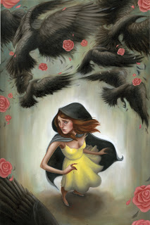
The Seven Ravens
All: Reflect on the Theatre Practitioner Artaud and use their knowledge and understanding to hold structured discussions.
Most: Apply concepts of universal language, symbolic movements and actor/audience relationships are key within this theory.
Some: Evaluate and conclude effectively using specific dramatic vocabulary and terminology when reflecting and discussing.
Working as a whole group you are to:
Use the story 'The 7 Ravens'
You are to read the short story.
Split the story in to 5 accessible chunks.
You are then to devise and perform sections of the story
Your focus MUST be on Artaud’s theories.

Slide 57
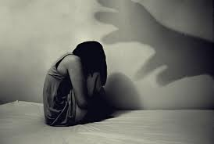
All: Reflect on the Theatre Practitioner Artaud and use their knowledge and understanding to hold structured discussions.
Most: Apply concepts of universal language, symbolic movements and actor/audience relationships are key within this theory.
Some: Evaluate and conclude effectively using specific dramatic vocabulary and terminology when reflecting and discussing.
Artaudian Nightmares!
How could you…
make your audience feel very uncomfortable and unnerved without touching them?
instil fear into the minds of the audience?
use your proxemics?
use performance space?
Focus on:
the way you speak the words – unnaturally
creating a new language for theatre
ACTOR / AUDIENCE RELATIONSHIP
Symbolic Physicality
Unnerve
Disturb
Shock
Abstract
Atmosphere
Loud noises

Slide 58
Personal Reflection
All: Reflect on the Theatre Practitioner Artaud and use their knowledge and understanding to hold structured discussions.
Most: Apply concepts of universal language, symbolic movements and actor/audience relationships are key within this theory.
Some: Evaluate and conclude effectively using specific dramatic vocabulary and terminology when reflecting and discussing.
Note down your responses how you worked under Artaudian influences this lesson.
How did you feel about what you were creating?
What did you notice about how you worked today?
Are you going to do anything different next lesson?

Slide 59
Forming your Opinions
All: Reflect on the Theatre Practitioner Artaud and use their knowledge and understanding to hold structured discussions.
Most: Apply concepts of universal language, symbolic movements and actor/audience relationships are key within this theory.
Some: Evaluate and conclude effectively using specific dramatic vocabulary and terminology when reflecting and discussing.
Now you have studied the work of three influential practitioners you must write your own manifesto for theatre.
You must comment on; How the work of the three practitioners have helped you formed your opinions in relation to the statement ‘Theatre is…’.
You can comment on things you don’t agree with as much as what you do.
No more than 1000 words.
You must also collate your notes as you will need them throughout the course

