Slide 1
Deadlines
Purpose of the Investigation
Methodology
Data Representation
Data analysis and explanation/interpretation
Conclusions and evaluation
Final Feedback Given 29th November
FINAL SUBMISSION DATE

Slide 2
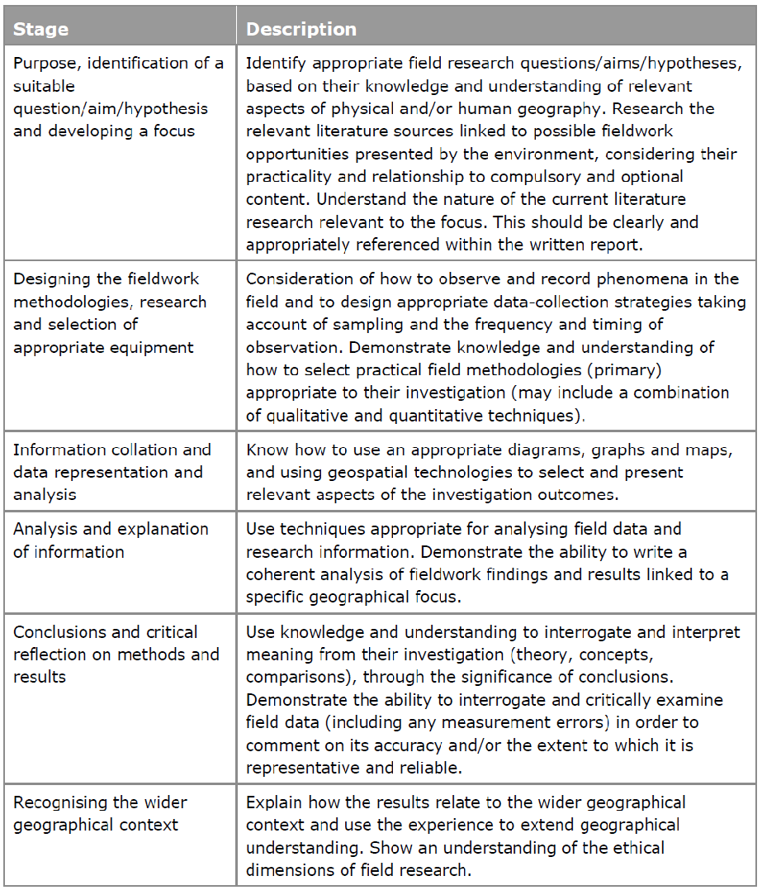
Section | Mark
Introduction | 12
Fieldwork | 10
Data Representation, Analysis, Interpretation and Evaluation of Techniques and Methodologies used | 24
Conclusions and Critical Evaluation of the Overall Investigation | 24
Total | 70
Notes:
This table is on page 68 of the specification and it shows the Route to Enquiry that students should following during their Independent Investigation.

Slide 3
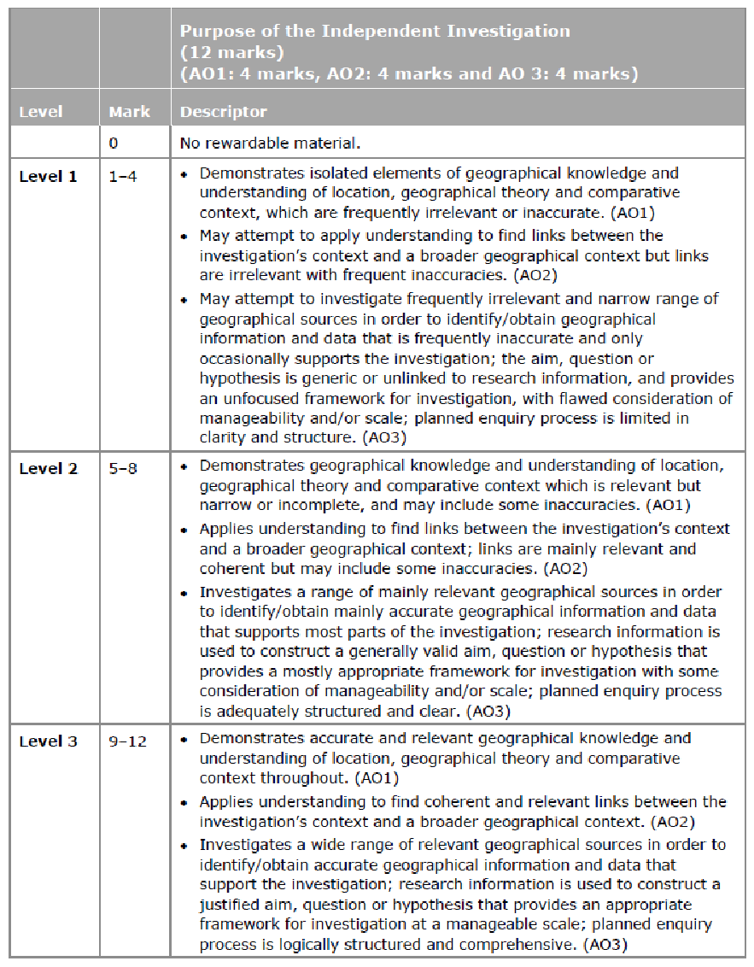
Geographical knowledge
Level 3: Demonstrates accurate and relevant geographical knowledge and understanding of location, geographical theory and comparative contexts throughout
Links between the investigation’s context and a broader geographical context
Level 3: Applies understanding to find coherent and relevant links between the investigation's context and a broader geographical context.
Geographical Sources
Level 3: Investigates a wide range of relevant geographical sources in order to identify/obtain accurate geographical information and data that support the investigation
Framework for investigation
Level 3: Research information is used to construct a justified aim, question or hypothesis that provides an appropriate framework for investigation at a manageable scale; planned enquiry process is logically structured and comprehensive.

Slide 4
Marking some examples
Read through the three examples.
Using the mark scheme award each piece of work a level.
Remember, these were written pre-2008 and therefore GIS/internet research wasn’t was widely available.

Slide 5
Example 1 - Crime
It was thought that this write up was secure in level 2. This was because:
Demonstrates geographical knowledge and understanding of location, geographical theory and comparative context which is relevant but narrow or incomplete, and may include some inaccuracies. (AO1)
There is reference to theory throughout such as p1 but it is narrow –the write up could have examined perceptions of different types of crime.
Applies understanding to find links between the investigation’s context and a broader geographical context; links are mainly relevant and coherent but may include some inaccuracies. (AO2)
There are links with a broader context in the discussion of the accuracy of perception p2
Investigates a range of mainly relevant geographical sources in order to identify/obtain mainly accurate geographical information and data that supports most parts of the investigation; research information is used to construct a generally valid aim, question or hypothesis that provides a mostly appropriate framework for investigation with some consideration of manageability and/or scale; planned enquiry process is adequately structured and clear. (AO3)
There are a range of sources such as newspapers p3 and police data p4. It would be far easier now to obtain a wider range of sources such as crime data from the internet. If this investigation was carried out today productive secondary sources could be the Crime Domain element of the IMD and actual crime data which would have allowed a discussion of what constitutes ‘crime’ – this could then have be addressed in this section and then revisited in the evaluation.

Slide 6
Example 2 - Beaches
It was thought that this write up was secure in level 3. This was because
Demonstrates accurate and relevant geographical knowledge and understanding of location, geographical theory and comparative context throughout. (AO1)
It is important to realise that this criteria is encouraging the candidates to demonstrate their relevant geographical knowledge throughout the write up and not just in the introduction.
The student has demonstrated this throughout the write up such as p1, p17 p20. There is clear understanding shown in the explanations of the factors affecting beach profiles.
It is important to consider that the configuration of the beach is not factored in. The wave refraction will be very different given the very different map forms of these two beaches.
The much more open profile of Vazon, which is substantially larger and the smaller more constricted form of Fermain will inevitably affect wave height and therefore profiles.
It is not necessary for the student to investigate the effect of wave refraction, but they should evaluate this as a limitation in the last section of the write up.
Applies understanding to find coherent and relevant links between the investigation’s context and a broader geographical context. (AO2)
This can be achieved in a variety of ways – as with the previous criteria it does not have to be in the section titled ‘introduction’. In this case the student relates it to other factors on p20 as well as relating it to broad ideas of meteorological conditions on p3. As with the issue concerning wave refraction it would have been very useful to know if either if these beaches are managed and the possible effect that this would have had on the results gained.
Investigates a wide range of relevant geographical sources in order to identify/obtain accurate geographical information and data that support the investigation; research information is used to construct a justified aim, question or hypothesis that provides an appropriate framework for investigation at a manageable scale; planned enquiry process is logically structured and comprehensive. (AO3).
This criteria will always be dependent on the individual title. It is important to remember that a broad range has also to be manageable. In this case there is some reference to text books (p21) and nice use of an exposure rating. The write up might have been improved by referencing the authors in the text and perhaps using some ‘classic’ text books such as Pethick. The student could also investigated the effects of wave refraction as well as human influence and could have referenced the Shoreline Management Plan.

Slide 7
Example 3 – Sand Dunes
It was thought that this write up was secure in level 2. This was because
Demonstrates geographical knowledge and understanding of location, geographical theory and comparative context which is relevant but narrow or incomplete, and may include some inaccuracies. (AO1)
There is reference to theory throughout the write up but some of it is not relevant nor particularly accurate such as the sediment sink diagram on p 1.
Applies understanding to find links between the investigation’s context and a broader geographical context; links are mainly relevant and coherent but may include some inaccuracies. (AO2)
There are tentative links with implicit impact of humans discussed in the explanation of results (explanation of blow outs p20) and discussion of temporal aspects of sand dune development on p23. It is important to note that the three hypotheses are very ‘routine’ – it might have benefitted the student if they had spread out the transects and focussed on west – east variation along the beach. This would have allowed greater analysis and synthesis of the results gained.
Investigates a range of mainly relevant geographical sources in order to identify/obtain mainly accurate geographical information and data that supports most parts of the investigation; research information is used to construct a generally valid aim, question or hypothesis that provides a mostly appropriate framework for investigation with some consideration of manageability and/or scale; planned enquiry process is adequately structured and clear. (AO3)
There are a few sources cited in the bibliography (p 26) and there was evidence some personal research with green keepers on p23.

Slide 8
So what should your introduction include?
Aim of the study
Literature Review
Sub-questions
Justification for the Investigation
Location

Slide 9
Aim of the study
A statement of what your geographical enquiry wants to achieve.
A well-thought out enquiry aim will be geographically sound and achievable.
“An investigation into the effectiveness of traffic calming measures in Leeds.”
“An investigation into the reliability and variability of regional weather forecasts when compared with local primary data in Wimbledon.”

Slide 10
Literature Review
Citing from a wide range of sources, a Literature Review should aim to:
  Show what is already known about your topic by geographers
  Show any models or theories in relation to your topic
  Show where gaps in the existing geographical knowledge occur (and how your study aims to fill them)
  Suggest why it is important to study this particular topic

Slide 11
What should I research?
GIS landscape sampling and analysis
Data sets and reports from specialist organisations (e.g. ONS data, Mayor’s Office London)
Contemporary articles from journals
Textbooks (beyond the usual course textbooks)
Appropriate theory
Digital data sources and social media

Slide 12
Referencing
If you use someone else's work, you must acknowledge your original source or sources. Referencing means acknowledging your source:
  in the body of your work (in-text referencing or citation ) AND
  linking your citations to your list of works cited (also reference list or bibliography).
Harvard Style Referencing
  Citing one author
  … and in some regions the need for food security may actually create justification for land grabbing (Nally, 2015).
  Citing two or more authors
  Despite European regulations for urban sustainability, cities like Sarajevo have actually developed unsustainably due to the urgent need to deal with vulnerable groups (such as homeless people) (Martin-Diaz et al., 2015).
  “the built environment of the city has moved in an increasingly unsustainable direction as a result of the need to deal with vulnerable groups in the population” (Martin-Diaz et al., 2015).

Slide 13
Bibliography
Create a table like this in a word document.
We will teach you how to write this as a correct reference list at the end of the investigation.
Author | Date of publication or access | Name of book, article, website | Place of publication | Page numbers used

Slide 14
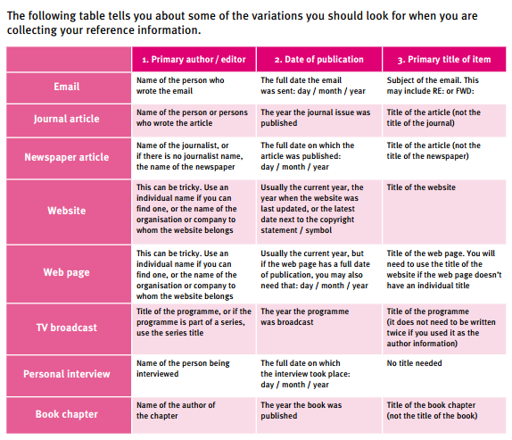

Slide 15
Sub-questions
Key research question(s) are used to frame the enquiry.
One question may serve as the overall enquiry title, while additional questions are used to help sub-divide the written report.
You need to insert these after your literature review.

Slide 16
Justification for the Investigation
This should explain to the reader why it is important that studies such as yours are done and what value they might hold in the wider geographical world.

Slide 17
Location
This can be done through a written description as well as visually through a series of linked maps, showing the location of the research at increasingly more detailed scales.
Use of mapping websites can be useful here as can GIS packages.
Use digimap or google maps to do this.
If you are focusing on one particular ward it may be worth including a map of this. Remember to reference where you get the map from.

Slide 18
Formatting Recommendations
Use A4 page size
Choose line spacing that aids readability [1.5 line spacing]
Use Arial, Times New Roman, Verdana, Candara or Calibri Fonts (11–12 point)
Use page numbers
Use spell/grammar check
Include word count on the front cover page
Include the following in a header or footer:
  5-digit centre number
  Candidate number
  Component code
Abbreviations (acronyms) can be used if they are in common use and are meaningful to the reader. They should be explained in the first instance, e.g. ‘HDI (Human Development Index)’.
Tables and figures, in general, should be comprehensible without reference to the text, i.e. labelled and numbered, followed by a short description of the contents.

Slide 19
What is data collection?
Data is any kind of information that, once analysed, can help you to answer your research questions and either prove or disprove your hypotheses.
The data collection section of your Independent Investigation is the point where you describe and explain the methods you plan to use, or those you have used, in order to get hold of your data.

Slide 20
Chooses appropriate methods to collect a range of data
Level 3: Chooses appropriate methods to collect a range of data and
information relevant to the geographical topic.
Designs a valid sampling framework that considers both frequency and timing of observations.
Level 3: Designs a valid sampling framework explicitly linked and appropriate to the geographical focus being investigated that considers both frequency and timing of observations.
Research planning shows understanding of the ethical dimensions of field research methods
Level 3: Research planning shows appropriate and relevant understanding of the ethical dimensions of field research methods.
Uses methods with high levels of accuracy/precision
Level 3: Obtains reliable data and information as a result of consistent use of methods with high levels of accuracy/precision.

Slide 21
What do I need to think about?
What data do I need to collect?
How do I collect this data?
What sheets do I need to design to record this data?
Where will I collect this data?
What sampling will I use and why?
Can I use GIS in the field?
Am I collecting both qualitative and quantitative data?
Qualitative Data. This is data that does not hold a numerical value.
Quantitative Data. This is data that can be measured using numbers.

Slide 22
Ethical and social issues of data collection
Urban project
Names and addresses, for example ,may have to be kept anonymous
Behave sensitively to personal opinions on social challenges and what information people might be prepared or willing to share with you
Coasts project
Think about the measures you will take to minimise your own negative impact on the area.
Think whether the act of you collecting data actually causes harm to the environment you are in.
Whilst it is very difficult to plan for every eventuality, describing in your write-up how you best tried to manage difficult circumstances will show how well you planned your methodology.

Slide 23
Data collection techniques
Useful websites
https://drive.google.com/drive/u/1/folders/0B0QAx84xTMKwLWYxNW5fcFdzTlk?hl=en_GB
Sanddunes
http://www.field-studies-council.org/centres/rhydycreuau/learn/schools/info-for-teachers/resources/sand-dunes.aspx
Ecological sampling methods http://www.countrysideinfo.co.uk/what_method.htm
Eighty fieldwork techniques
https://mrsgeographyblog.wordpress.com/2017/01/13/eighty-fieldwork-techniques/
Notes:
http://www.hsiensw.com/uploads/4/7/7/1/47718841/geography_fieldwork_techniques_final.pdf

Slide 24
What information do I need to collect? | What techniques would collect this? | What sampling strategy will I use? | What is the frequency of the collection? Sample size, timings | Any ethical/social considerations | Data collection sheet done
Judge quality of environment of quayside | photos | At each site | Many
 | EQS | At each site | Once at each site. Could repeat at various points in day?
 | Litter survey | At each site | Once at each site. Could repeat at various points in day?
 | Graffiti survey | At each site | Once

Slide 25
